Slide 1
Audio Speech Analysis
using NLP
Prepared by: Mohamed Ziauddin Date: 27-Nov-2021

Slide 2
Problem Overview
Problem Statement
Task is to perform analysis on an voice/speech downloaded from internet.
Task includes
Convert speech to text using Python
Conduct sentiment analysis on the text data
Find the topics in the text using LDA.
Find salient entities in the speech

Slide 3
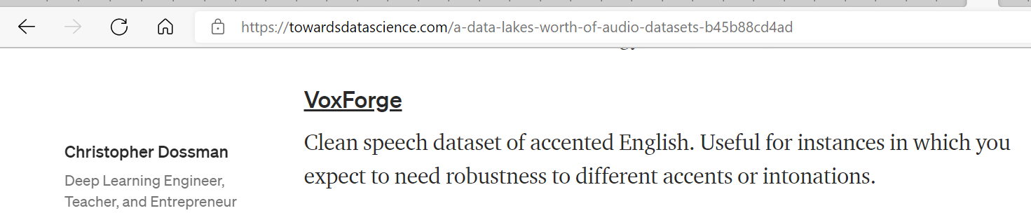
Problem Dataset
Data set
Traversed thru the site https://towardsdatascience.com/a-data-lakes-worth-of-audio-datasets-b45b88cd4ad and found a voice audio data from the site www.voxforge.org

Slide 4
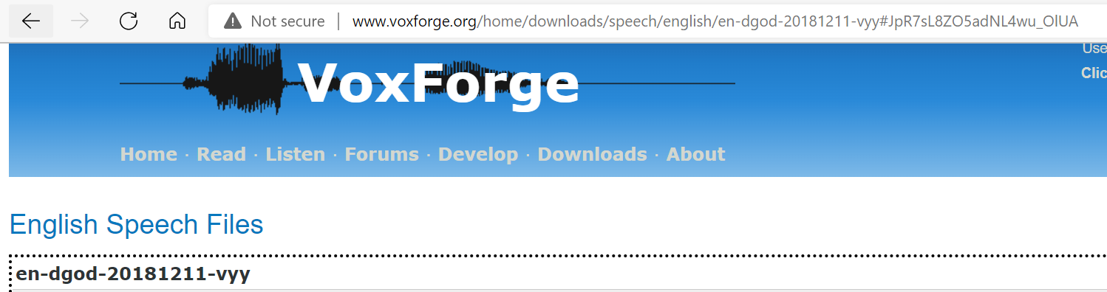

Problem Dataset...contd
Sample Data

Slide 5
Observations
Dataset contains 10 audio files
File is of .wav format
Sampling rate is 48000
Sample rate format is 16
No. of channels is 1
Language is English
Size of the audio files is around half a MB each

Slide 6
Data Transcription
Upload each audio file into the speech recoginition library
Convert into format containing audiodata
Transcribe the audiodata into text using recognize engine/api
Fix the contractions using contractions library
Sample Transcribed Text Output
"but I am more focused on the content"

Slide 7
Sentiment Analysis
Analyse the sentiments using textblob library
NaiveBayesAnalyzer is used to predict the sentiments
The sentiments are classified whether positive or negative
Feedback based on probability ourcome
Text: "but I am more focused on the content"
Sentiment
(classification='pos',
p_pos=0.7562354821735098,
p_neg=0.24376451782648972)
Above text is classified as positive

Slide 8
Topic modelling
Perform topic modelling using the nltk library
Standardize all the words into lowercase
Tokenize the data
tokens: ['but', 'i', 'am', 'more', 'focused', 'on', 'the', 'content']
Find the stop words
stop_tokens: ['focused', 'content']
Lemmatize the words using wordnet
lemma_tokens: ['focused', 'content']
Create dictionary for the lemmatized tokens using gensim
Dictionary(35 unique tokens: ['impeccable', 'service', 'music', 'relaxing', 'soothing']...)
Make corpus for the data using the bag of words from dictionary created

Slide 9
Topic modelling...contd
Create a model using LDA model in gensim
Find the topic by pass on the corpus and dictionary
[(1, '0.071*"mark" + 0.071*"pic" + 0.071*"office" + 0.071*"took" + 0.071*"spelling"'),
(5, '0.200*"service" + 0.200*"impeccable" + 0.018*"will" + 0.018*"eaten" + 0.018*"front"'),
(3, '0.029*"impeccable" + 0.029*"content" + 0.029*"eaten" + 0.029*"meal" + 0.029*"will"'),
(9, '0.147*"content" + 0.147*"auto" + 0.147*"accident" + 0.147*"focused" + 0.013*"meal"'),
(2, '0.029*"house" + 0.029*"music" + 0.029*"eaten" + 0.029*"spell" + 0.029*"will"')]

Slide 10
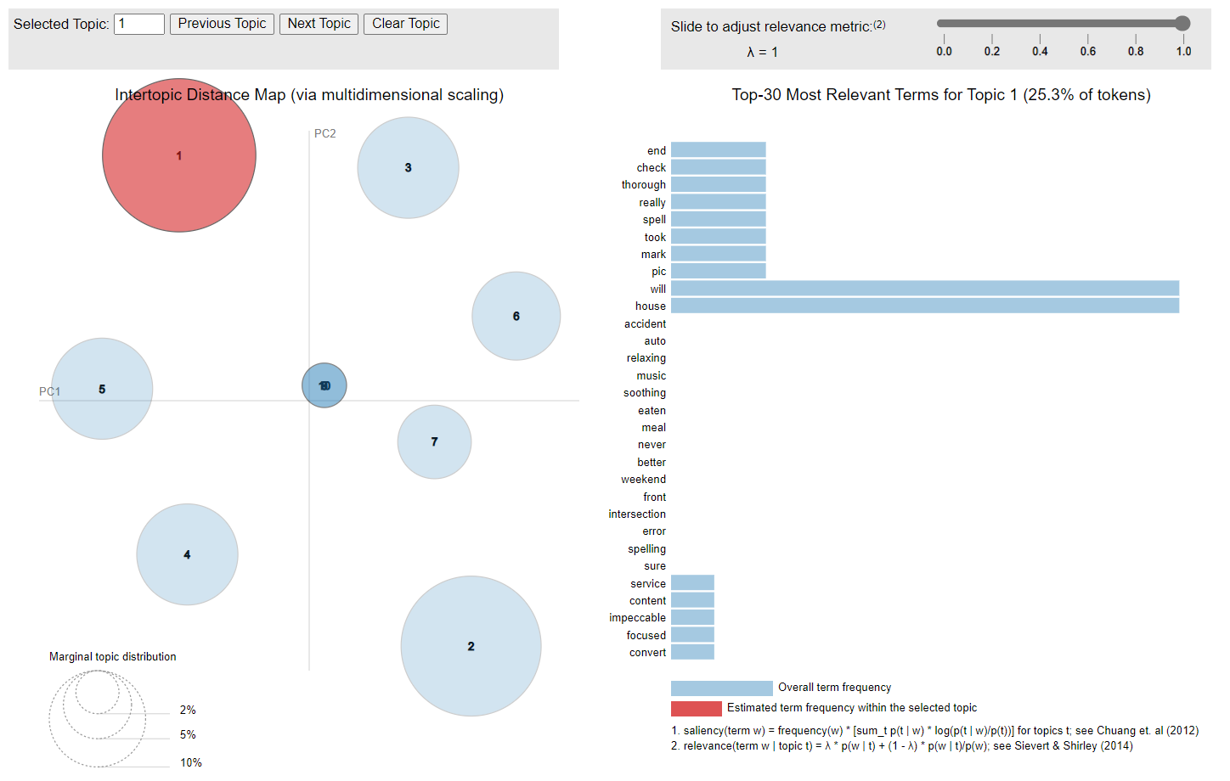
Topic modelling...contd
↑
Press here
for visual

Slide 11
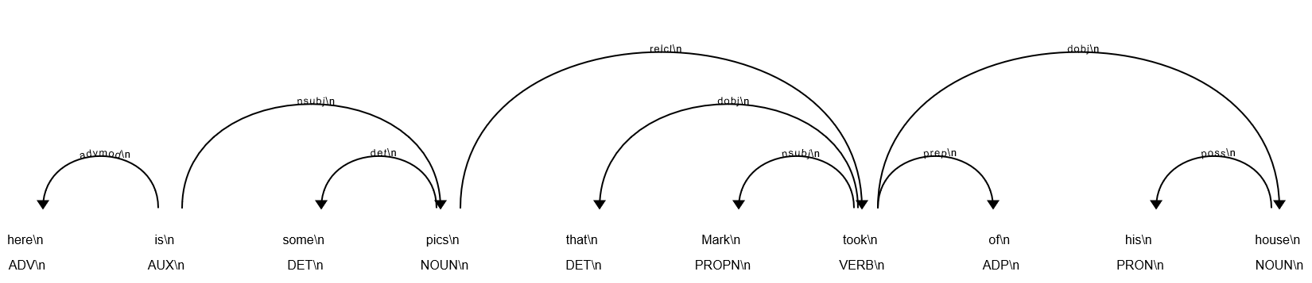
Named Entity Recognition
Recognize the named entities using spacy library
here is some pics that Mark took of his house
[(Mark, 'PERSON')]

Slide 12
Entity Analysis
Most frequent named entities obtained
Entity Name | Entity Type
Mark | PERSON
Mill | PERSON
Quebec | GPE
this | DATE
weekend | DATE

Slide 13
Entity Analysis...contd
Top named entities obtained
Top named entity types
Entity Name | Mark | Mill | Quebec | this | weekend
Entity Type | PERSON | PERSON | GPE | DATE | DATE
Frequency | 1 | 1 | 1 | 1 | 1
Entity Type | DATE | PERSON | GPE
Frequency | 2 | 2 | 1

Slide 14
Thank You

